Slide 1
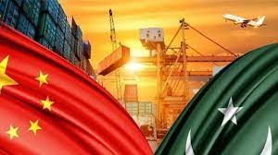
A performance of China Pakistan Free Trade Agreement Phase I & II Export Analysis of Pakistan (313 Tariff Lines)
By
Afshan Uroos
Deputy Manager, TDAP
Dated: 30 June 2022

Slide 2
SCHEME OF PRESENTATION
OVERVIEW OF PAKISTAN CHINA TRADE AGREEMENTS
TRADE & TARIFF ANALYSIS OF CPFTA PHASE-I
Tariff Reduction Modalities of CPFTA-I
IMPACT ANALYSIS
TRADE & TARIFF ANALYSIS OF CPFTA PHASE-II
Tariff Reduction Modalities Under CPFTA-II
ANALYSIS OF CPFTA-II 313 TARIFF LINES AND ITS SECTORIAL UTILIZATION

Slide 3
OVERVIEW OF PAKISTAN CHINA TRADE AGREEMENTS
TRADE & TARIFF ANALYSIS OF CPFTA PHASE-I
Tariff Reduction Modalities of CPFTA-I
IMPACT ANALYSIS
TRADE & TARIFF ANALYSIS OF CPFTA PHASE-II
Tariff Reduction Modalities Under CPFTA-II
ANALYSIS OF CPFTA-II 313 TARIFF LINES AND ITS SECTORIAL UTILIZATION
Contents
CHINA PAKISTAN FREE TRADE AGREEMENT

Slide 4
Introduction
Pakistan and China are members of (WTO) since 1st January 1995 and 11 December 2001
Share strong economic and trade relationship
FTA of Pakistan and China is significant on several levels
Establishes the long-lasting trade association
Both are involved in FTAs with other economies
China maintains 16 FTAs with ASEAN, Singapore, Pakistan, New Zealand, Chile, Peru, Costa Rica, Iceland, Switzerland, Maldives, Mauritius, Georgia, Korea, Australia, Hong Kong, and Macao
Pakistan maintains 03 FTAs with China, Malaysia and Sri Lanka
To improve bilateral trade (export growth specifically)

Slide 5
Background of the study
CPFTA Phase-1 became operational in 2007.
little improvement to attain the benefits from Pakistan-China FTA
It was observed/criticized at different fora for providing preferential access of Chinese products into Pakistan
The local industry of Pakistan also raised concerns on various occasions regarding Pakistan-China FTA
To analyze the impact of CPFTA II on trade and identify the sectors wherein an elimination of trade tariff result in mutual benefit and maximization of return

Slide 6
Literaure Review
Name of Author | Title | Analysis
Rafaia Khan 2020 | Impact of Pak-China Free Trade Agreement (FTA) on Trade and Industry of Pakistan | evaluates the impact of Pakistan & China FTA (Free Trade Agreement) on Exports and Trade Flows Growth of Pakistan on Time Series and Panel Data of Exports of last 15 years from July 2003-June 2017
Hamid Mukhtar 2019 | A critical analysis of China Pakistan free trade agreement: learning experiences for Pakistan with respect to its future FTAs | This research critically analyzed China Pakistan Free Trade Agreement to find out why Pakistan could not derive the expected benefits form CPFTA? Recommendations for consideration of the Government of Pakistan with respect to signing of its future FTAs is reported in the paper
Irshad, Muhammad Saqib & Xin, Qi2017 | Pakistan-China Free Trade Agreement (PCFTA) Treaty Model: Capability, Prospects and Disputes | Countries like China, Bangladesh and India benefited largely from FTAs and emerged as international leaders of this industry. The research concluded with the remarks that highest value addition is required for Pakistan to achieve the same
Samina Shabir and Reema Kazmi 2007 | Economic Impacts of the recently signed Pakistan China Free Trade Agreement | FTA offers a huge potential for Pakistan’s economy, yet the country needs to make its exports with China more diversified

Slide 7
objectives of the study
To compare CPFTA-I & II
To find utilization rate of the CPFTA II
To analyze 313 tariff lines included in phase II
Reasons for sluggish growth in the exports to China

Slide 8
Data Sources and data variables
Electronic Data Exchange (EDE)
Custom data (Electronic Data Exchange) of different ports where export to China is recorded under FTA
Other data sources
Trade Map (ITC)
World integrated Trade Solution (wits)
Weboc
State Bank of Pakistan
Tariff Lines (variables)
313 highly prioritized tariff lines at HS 8 digit

Slide 9
Methodology
impact analysis (SMART)
Sectoral distribution
Utilization rates (through EDE system)
Qualitative approach (consultation with exporters)

Slide 10
Background of China Pakistan Trade Agreements
CPFTA - I
CPFTA II
EARLY HARVEST PROGRAM
Covers Trade in Goods & Investment
Signed in Nov 2006
Implemented July 2007
11 Rounds of Negotiations from 2011 – 2019
Entered into force on 1st December 2019
Implemented from 1st January 2020
Gained immediate zero-tariff market access on 782 items
Which include 313 tariff lines of Pakistan’s Prime export interest
1st January 2006
No of Tariff Lines Given by:
Pakistan: 486
China: 744
.

Slide 11
Overview of Pakistan China Bilateral Trade (USDMillion)

Slide 12
Overview of Pakistan China Bilateral Trade (USDMillion)
Variables | 2019 | 2020 | 2021
Pak exports to China | 2,043 | 1,868 | 3,043
Pak Share in China Import | 0.10% | 0.09% | 0.12%
Major Exports to China | Copper, Cotton yarn, Cereals, Rice, Sesemum Seed, undenatured ethyl alcohol, fruits, frozen Fish, Articles of apparel and clothing, & Salt; Sulphur, and Raw hides and skins.

Slide 13
Pakistan’s top export products to China(USDMillion)

Slide 14
Pak-China Free Trade Agreement (PCFTA-I)
China Offer List
Pak Offer List
7500
Concessions
6803
Concessions
35%
Zero Rated
0%
electronics, machinery, chemicals & raw materials
No concessions
i.e. fish, cotton, paper, rice, plastic & textile
15%
92
No concessions
i.e. woven fabrics, synthetic fibers, paper, alcohol, drugs, arms and footwear.
CPFT Phase II implementation started from January 2020

Slide 15
CHINA PAKISTAN FREE TRADE AGREEMENT PHASE I
TRM OF CHINA
TRM OF PAKISTAN
No. of TLs
% of TLs at 8 digit
% of TLs at 8 digit
No. of TLs
;
I
Elimination of Tariff (3 years)
35.6%
2681
35.5%
2423.
II
(0-5%) 5 years
2604
34.5%
1338
19.9%
III
Reduction on MoP 50%
5 years
604
8%
157
2%
IV
Reduction on MoP from 20%
5 years
529
7%
1768
26.1%
V
V
15%
No Concession
1132
15
1025
VI
Exclusion
192
15%

Slide 16
Description of CPFTA II concessions offered to Pakistan by China
Category | Description | Tariff lines (HS 8-digits) | Tariff lines ( per centage)
A-0 | Duty-free access immediately | 3707 | 45
A-5 | Duty-free access by year 5 | 1235 | 15
A-10 | Duty-free access by year 10 | 1236 | 15
MOP-1 | Reduce base rates by 20 per cent in year 5 | 273 | 3
MOP-2 | Reduce base rates by 20 per cent immediately | 139 | 2
C1 | Tariffs remain at 2013 base rate | 835 | 10
C2 | No concession (MFN rates apply) | 813 | 10
Total lines |  | 8238 | 100

Slide 17
TARIFF REDUCTION MODALITIES CPFTA II
TRM OF CHINA
TRM OF PAKISTAN
% of TLs
years
years
% of TLs
I
45
Entry into Force
45.
Entry into Force
II
15
7 year
2ND-7 YEARSs
15
5 years
III
15
15 years
4-15 YEARS
15
10 years
20% Margin of Preference
5
ElF
5
ElF
Sensitive List
20
SL
20
SL
Both sides agreed to liberalization in terms of trade volume:
67% for Pakistan & 90% for China

Slide 18
MAIN FEATURES OF CPFTA-II
Both countries will liberalize 75% of tariff lines for each other in a period of 10 years by China and 15 years by Pakistan
China will immediately eliminate tariffs on 313 most priority tariff lines of Pakistan’s export interest
Overall, China has granted concessions to products which include textiles and garments, seafood, meat and other animal products, prepared foods, leather, chemicals, plastics, oil seeds, footwear as well as engineering goods including tractors, auto parts, home appliances, machineries, etc.
Pakistan has offered market access to China on raw materials, intermediate goods and machineries.

Slide 19
Main Features CPFTA II
25% of TLs have been placed in the protected list
Safeguard Measures (SGM) are invoked to temporarily restrict imports of a product Following modifications have been incorporated in the Agreement:
a. In Phase-I SGM were limited to the absolute increase in imports, but now can be invoked on relative increase in imports as well.
b. The transition period has been increased to 10 years for CAT-I and 8 years for the remaining tracks, which in relation to Tariff Reduction Modality will be 15 years for CAT-II & 23 years for CAT-III.
c. SGMs can be applied for 3 years, and can be extended to an additional 2 years. This has not been granted to any other country by China.
d. In Phase-I SGM, injury to the industry had to be proven but an emergency measure of 180 days can be imposed in Phase-II without proving injury.

Slide 20
MARKET ACCESS
BALANCE OF PAYMENT
This provision has been introduced in the Agreement as such measures can help to forestall the imminent threat of a serious decline in monetary reserves
ELECTRONIC DATA EXCHANGE
In order to avoid misdeclaration and under-invoicing, a system of Electronic Data Exchange has been enforced on the trade taking place under the framework of the Free Trade Agreement

Slide 21
Export Analysis pre & fost FTA (Gross)

Slide 22
Analysis of CPFTA - II
Three-tier methodology is used
Export Data for all products are analyzed in terms of export growth
Export data from Karachi port is analyzed
Export data from Bin Qasim port is analyzed separately
Empirical Results of EDE Export Data (2020)
 | 2020 | Under CPFTA (2020) | Utilization Rate
Exports of Pakistan to China (Total) | 1,867 | 1,076 | 58%

Slide 23
Performance of top sectors after phase II

Slide 24
Classification of 313 Tariff Lines
Animal Products
Articles of Apparel
(Sea food, Meat, Poultry, Milk & Cream, Honey)
28 Tariff Lines
Garment and made ups
105 Tariff Lines
Textiles
(Yarn & Carpets)
24 Tariff Lines .
Prepared Food Stuff
19 Tariff Lines
CPFTA II
Machinery
Leather
(Fans, Refrigerators, ACs, Hydraulic Pumps, Heat Exchange Units)
17 Tariff Lines
18 Tariff Lines
Vehicles
(Tractors, auto and motorcycle parts)
14 Tariff Lines .
Plastics, Articles of plastic
14 Tariff Lines

Slide 25
Classification of 313 Tariff Lines
(Chemicals)
Cereals & Fruits
(Soaps & Organic surface-active agents, make up preps, gelatin, others
13 Tariff Lines
10 Tariff Lines
Jewellery and Parts etc.
Footwear
9 Tariff Lines .
9 Tariff Lines
CPFTA II
Bedding Articles,
Mattresses, Electric Lamps
Others
(Electric accumulators, Sanitary Ware, Manicure/Pedicure Sets, Conductors, Cables, Cement, Glassware, Iron and Steel)
19 Tariff Lines
8 Tariff Lines
Oil Seeds, Vegetable Fats and Oils
7 Tariff Lines .

Slide 26
Analysis of Utilization of 313 tariff lines
Empirical Results of Analysis through EDE system | HS | No of Tariff Lines | Utilization Rate @ Port Qsim | Utilization rate @ Karachi port | Total
Sector | HS | No of Tariff Lines | Utilization Rate @ Port Qsim | Utilization rate @ Karachi port | Total
Agro & Food | HS-01 to HS-24 | 64 | 5 | 2 | 6
Textile & its Articles | HS-50 to HS-63 | 129 | 34 | 25 | 42
Leather & its Articles | HS-40 to HS-43 | 18 | 4 | 0 | 4
Footwear | HS-64 | 9 | 0 | 0 | 0
Chemicals cement others | HS-25 to HS-39 | 28 | 5 | 1 | 5
Other Engineering Goods | HS-65 to HS-99 | 53 | 1 | 1 | 1
Jewelry and stones | HS 68 -71 | 12 | 1 | 1 | 2
Total |  | 313 | 50 | 30 | 60

Slide 27
CPFTA – Findings
Exports of Pakistan to China in 2020 is term of value was recorded US$ 1.867 Billion.
However, exports Under CPFTA Framework (I-II) in the same year equates US$ 1.076 billion, which is 58% of exports.
Exports of Tariff lines under FTA from Karachi Port and Bin Qasim port highlights that negligible exports of 313 TLs were recorded under CPFTA-II 313
Engineering Goods,1 Jewelry and Footwear from 313 items were negligibleIn term of tariff lines, only 60 Tariff Lines are being utilized which equates to 19 percent of 313 TLs.
Non-Tariff Barriers are the main reason for lower utilization of concession • Proper Electronic system is not available to check the utilization rate of Trade agreement

Slide 28
Quantitative Analysis of CPFTA-II – Utilization Rate
Bilateral trade reached US$ 23.7 billion in 2021
Pakistan’s imports increased from US$ 12 billion to US$ 20 billion in 2021 after implementation of CPFTA-II.
Exports from Pakistan to China grew from US$ 2.04 billion in 2019 to US$ 3.04 billion in 2021
CPFTA Phase-II is independent of phase-I and based on the principle of “less than reciprocity” in favor of Pakistan
Pakistan also sought unilateral concessions on priority items from the Chinese side as a sign of goodwill to address the country’s concerns.
Pakistan also successfully sought revision of the safeguard measures (SGMs), which applied to temporarily restrict the import of a product, which caused injury or threatened to cause injury to a domestic industry

Slide 29
Unutilized Tariff Lines
CPFTA II
Meat
Processed Food
12 Tariff Lines of Meat HS 02
22 Tariff Lines
Fish
Miscellaneous
8 tariff lines of Fish HS 03
Chapter 25 to 39
9 tariff lines not utilized
Milk
Leather
02 Tariff Lines of HS 04
Chapter 41 to 43
13 tariff lines not utilized
Fruits
08 Tariff Lines of Chapter 08
Cotton Yarn & carpet
11 tariff lines not utilized
Apparel
Others
68 Tariff Lines of Chapter 61 and 62
84 Tariff Lines of Chapter 08

Slide 30
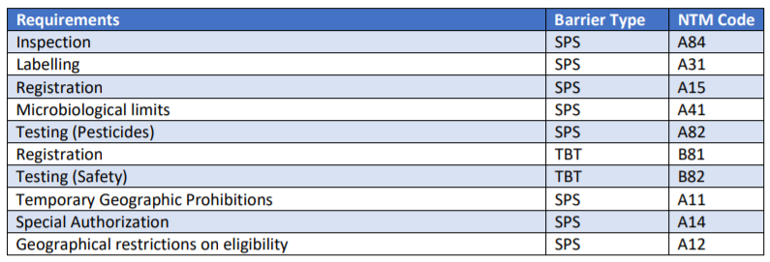
Non-Tariff Barriers
Exports of Pakistan to China are subjected to Excessively Regulated Sanitary & Phytosanitary (SPS), and Technical Barriers to Trade (TBT) related sanctions.
TBT like product requirement, labelling requirement, transportation under controlled Temperature.
Quarantine requirement for Agro and Food products .

Slide 31
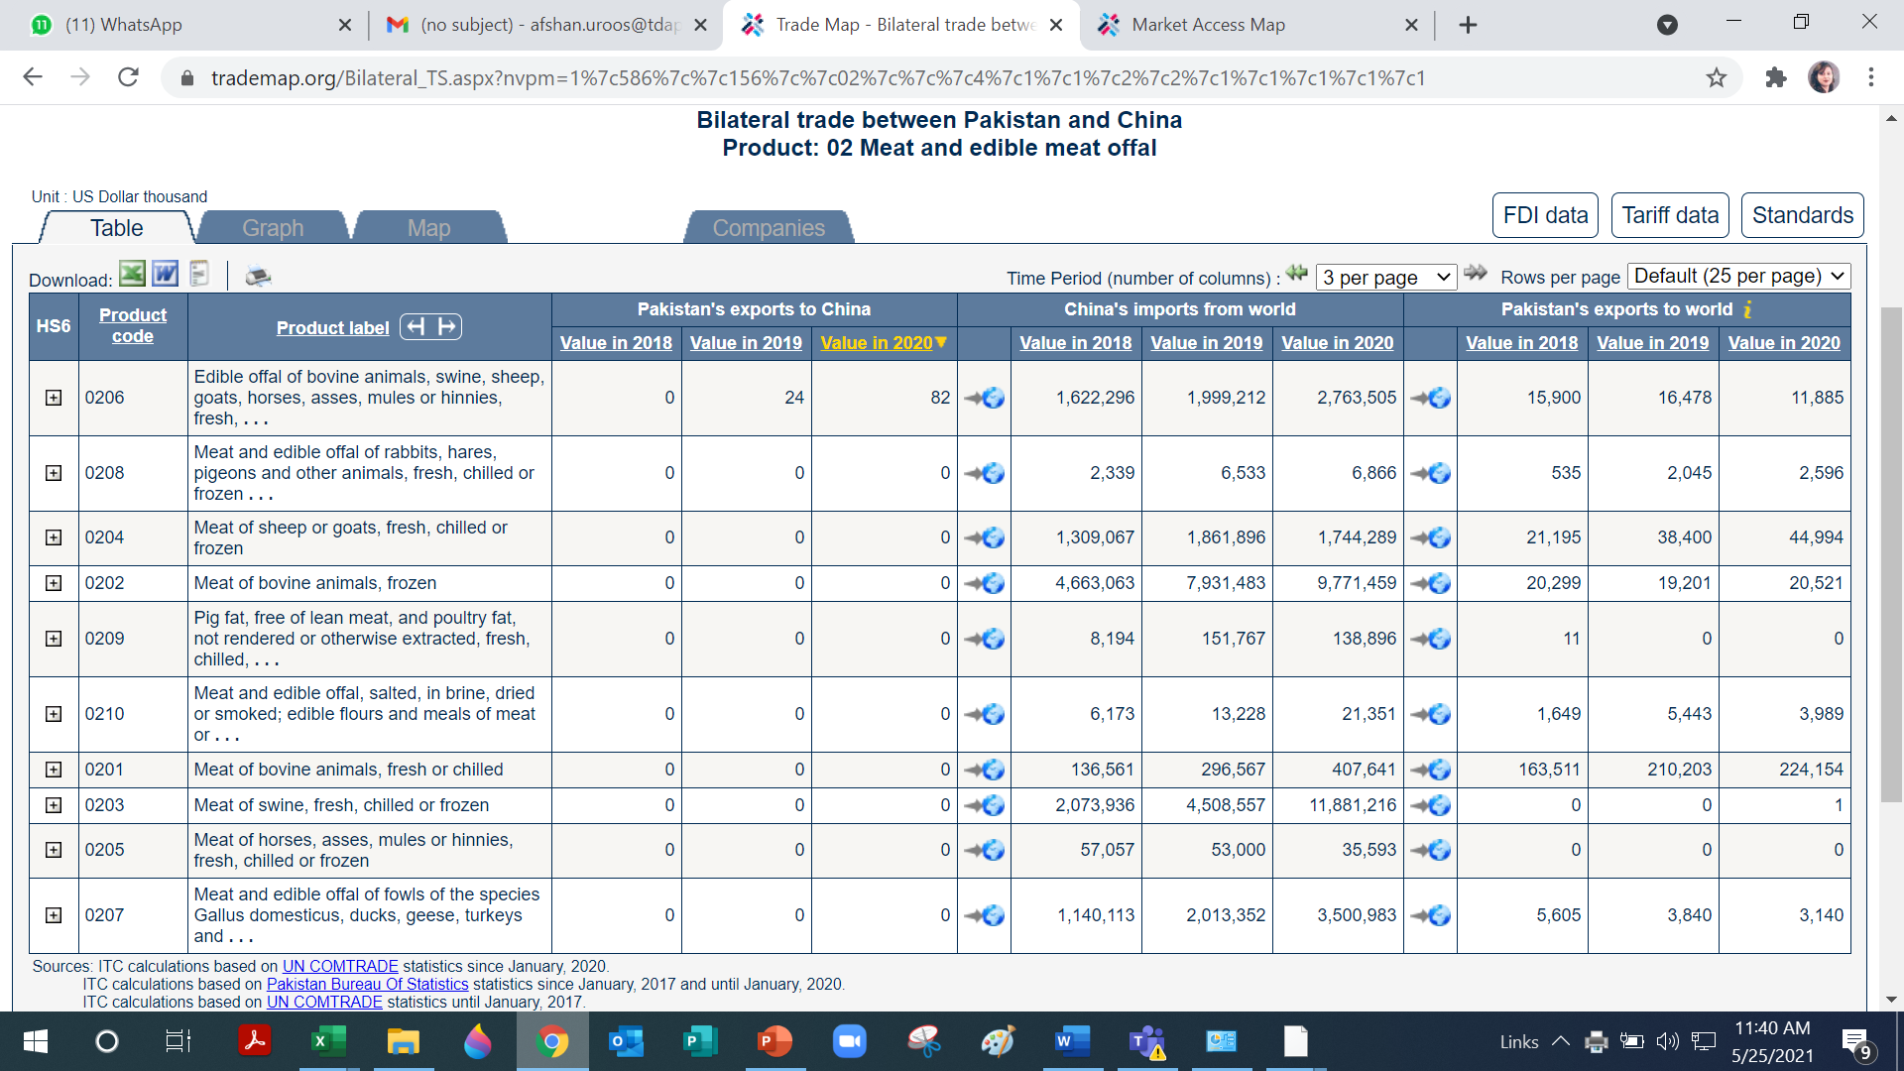
HS – 02012000 (Fresh or chilled unboned bovine meat (excl. carcasses)
https://www.macmap.org/en//query/results?reporter=156&partner=586&product=020120&level=6

Slide 32
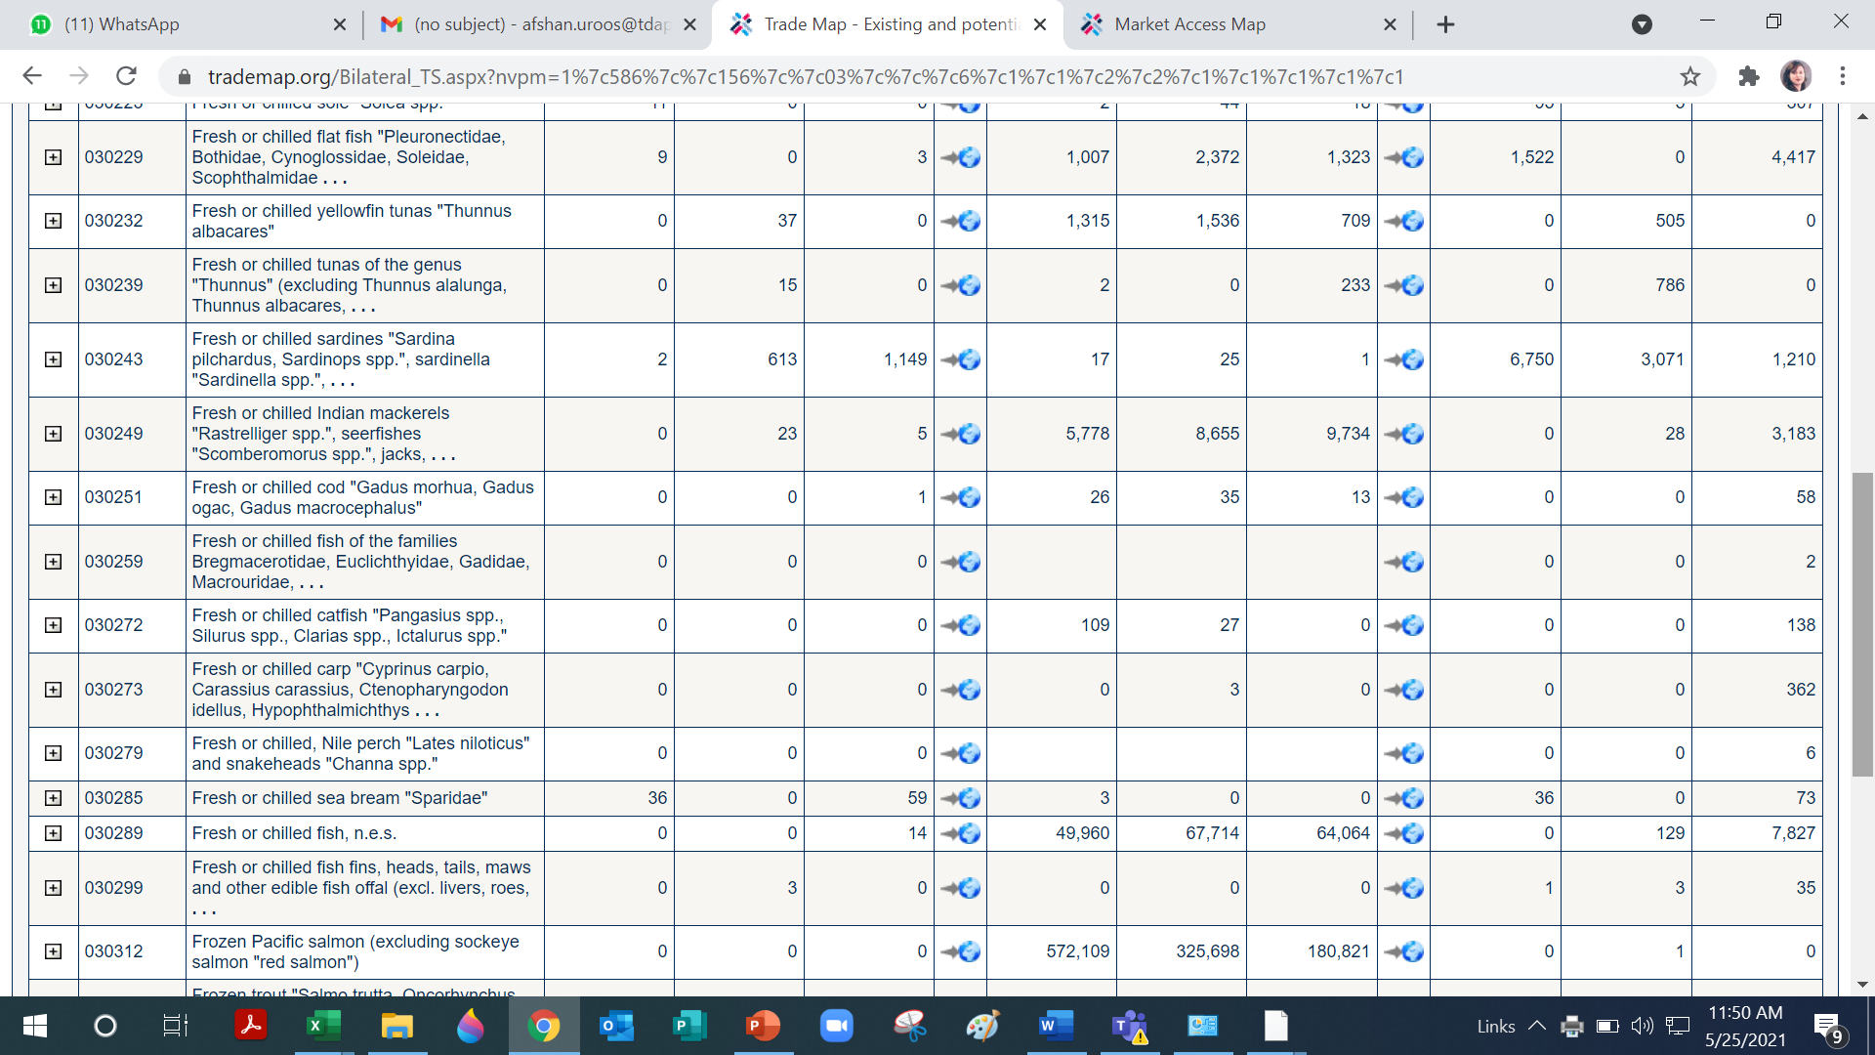
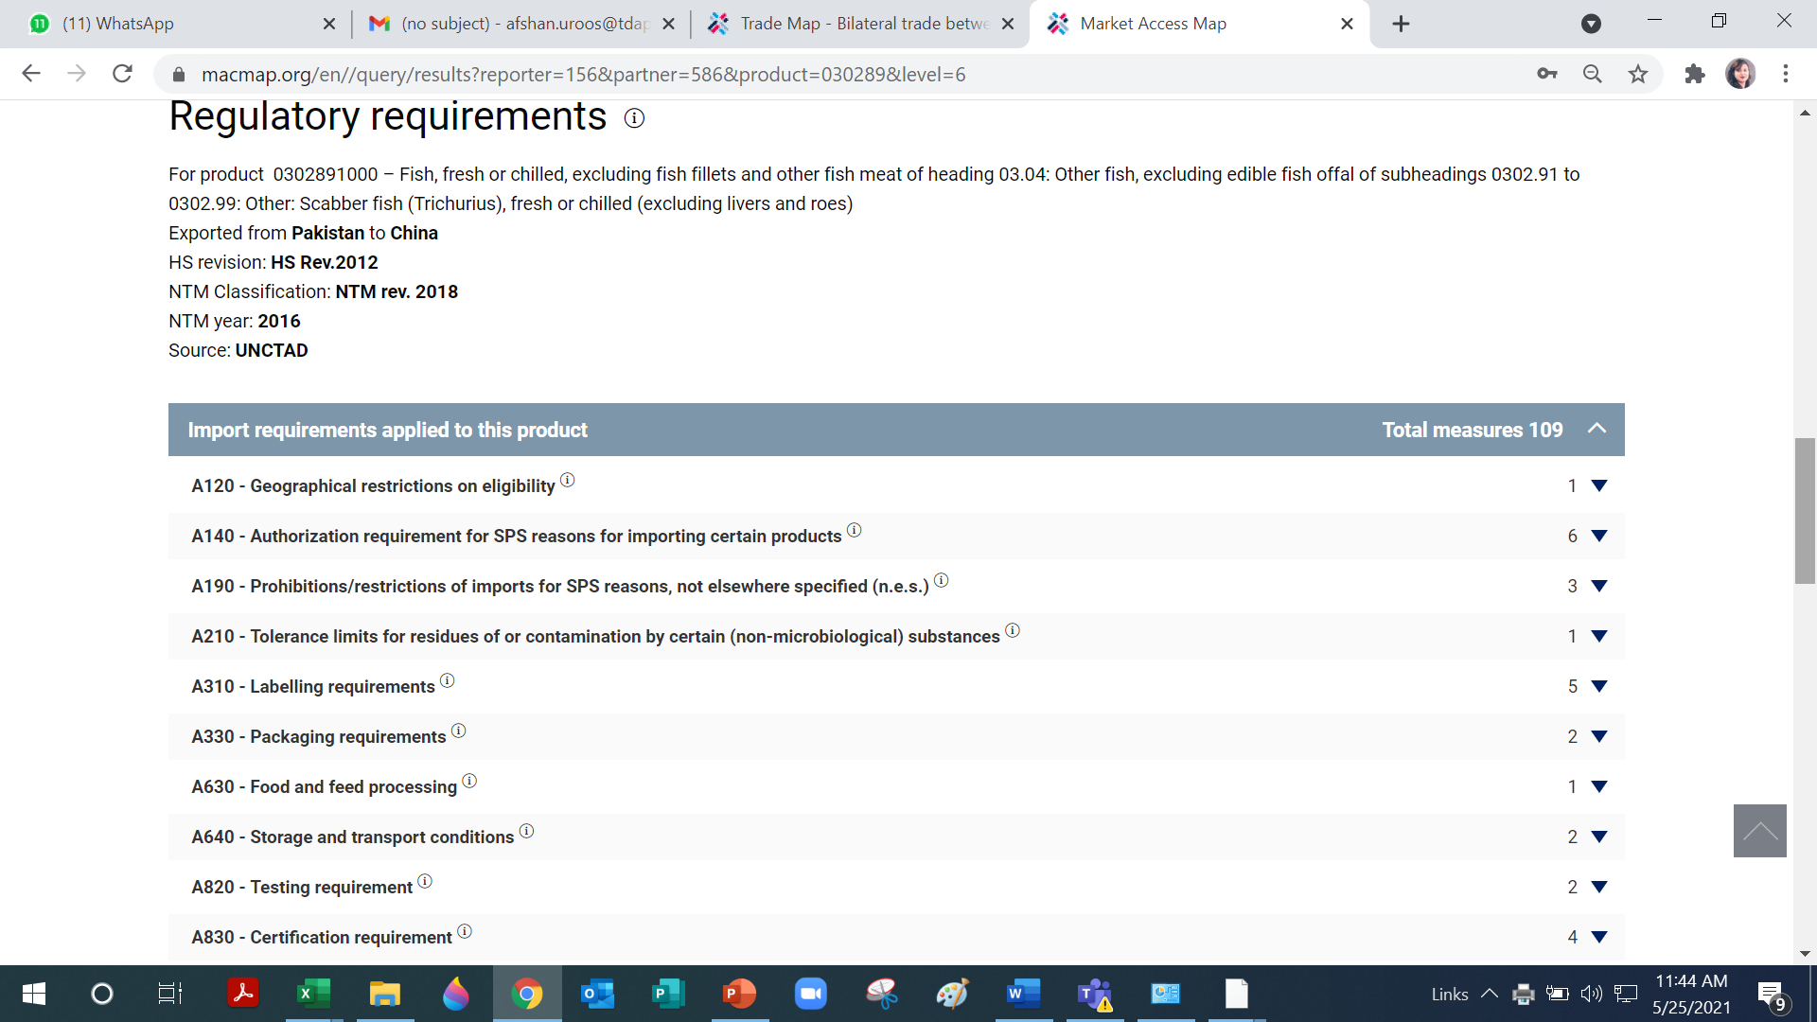
03028910 Fresh or chilled scabber fish (trichurius)
https://www.macmap.org/en//query/results?reporter=156&partner=586&product=030289&level=6

Slide 33
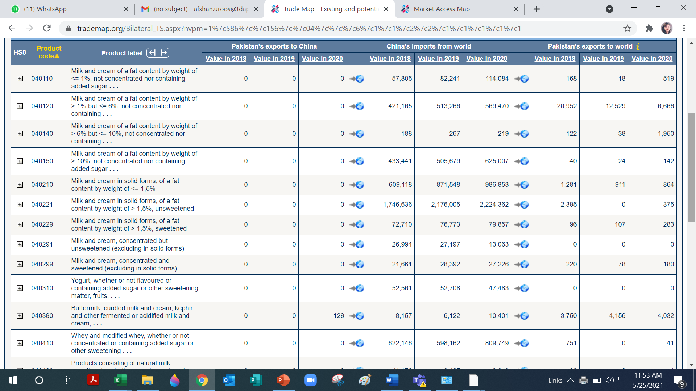
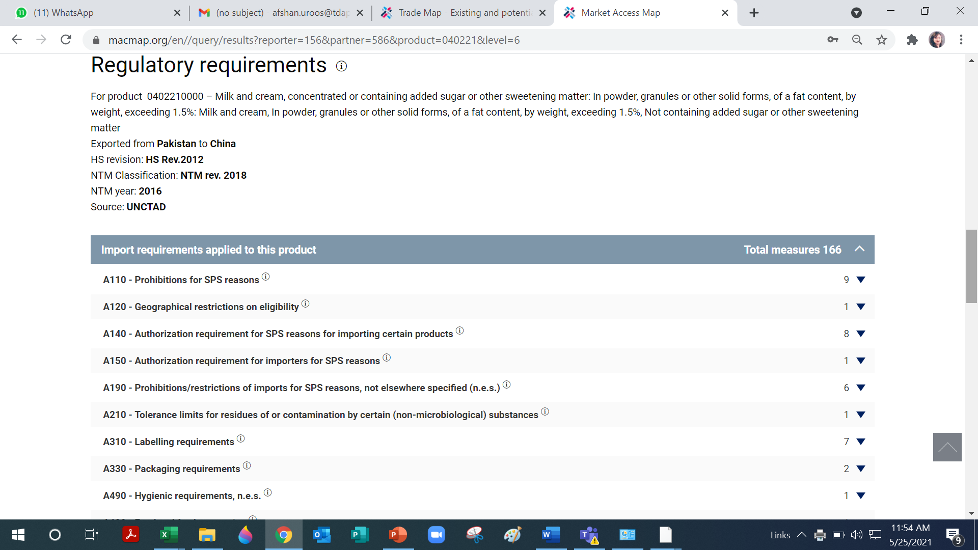
04022100 Milk and Cream
https://www.macmap.org/en//query/results?reporter=156&partner=586&product=040221&level=6

Slide 34
CPFTA – Findings
Limited tariff lines are utilized despite zero tariff
Non Tariff barriers are major hurdle to export
Copper exports have shown unusual pattern
Jewlllery exports under CPFTA II are negligible
Agro products have no. of NTBs

Slide 35
Recommendations
CPFTA II
EDE System
Testing labs
Testing and accreditation services should be available to smaller exporters who face difficulties in getting international laboratory tests.
System should be updated and improved
Exclusive web page of CPFTA tariff utilization
Cargo handling
Better technology for efficient cargo handling.
may be developed for the steps involved in exporting to China.
Role of Trade association and chambers
Role of Trade Missions
Exports Associations and Chambers should be activated to ensure that exporters can utilize the concessionary tariffs under the high priority tariff lines (313)
Trade Missions in China may be assigned to identify list of non-Tariff barriers of Highly prioritized items

Slide 36
Thank You

Slide 37
Analysis of Utilization of CPFTA -II
HS Code (8-DIGIT) | Description | MFN Rate 2013 | Phase I rate for Pakistan | Phase II rate for Pakistan | Utilization at Karachi Port | Utilization at Port Qasim
03033900 | Frozen flat fish (excl. halibut, plaice & sole) | 10 | 8 | 0 | 504 Transaction/20.617 Million | 2 Transaction / 85,154 Dollars
03035300 | Frozen sardines, brisling or sprats | 12 | 5 | 0 | 390 Transaction / 7.538 Million | 3 Transaction / 1,11,511 Dollars
03035400 | Frozen mackerel | 10 | 6.7 | 0 | 17 Transaction/ 0.538 Million | Zero Utilization
03049900 | Other fish meat, frozen | 10 | 5 | 0 | 33 Transaction / 0.002Million | Zero Utilization
34029000 | Surface-active preparations, washing preparations & cleaning preparations, not put up for retail sale | 9 | 5 | 0 | 1 Transaction / 37,780 Dollars | Zero Utilization
35030010 | Gelatin & gelatin derivatives | 12 | 6 | 0 | 1 Transaction / 38,550 Dollars | Zero Utilization
39031910 | Modified Polystyrene (excl. expansible), in primary forms | 6.5 | 5 | 0 | 51 tractions/ 14.571 Million | 1 Transaction / 1,56,351 Dollars
39031990 | Unmodified Polystyrene (excl. expansible), in primary forms | 6.5 | 5 | 0 | 48 Tranctions/ 4.73 million | Zero Utilization
39069090 | Acrylic polymers,in primary forms, nes | 6.5 | 5 | 0 | 8 Transaction/ 329,549 Dollars | Zero Utilization
41044990 | Bovine or equine leather, without hair on, dry state(crust) , not further prepared, nes | 7 | 4.9 | 0 | 4 Transaction/ 129,679 Dollars | Zero Utilization
41079200 | Leather further prepared after tanning or crusting, including parchment-dressed leather, of bovine (including buffalo) or equine animals, without hair on, whether or not split, other than leather of heading 41.14, other than whole hides and skins, grain s | 5 |  | 0 | 6 Transaction/ 285,981 Dollars | Zero Utilization
41120000 | Leather further prepared after tanning or crusting, including parchment-dressed leather, of sheep or lamb, without wool on, whether or not split, other than leather of heading 41.14 | 8 | 5.6 | 0 | 2 Transaction / 101,135 Dollars | Zero Utilization
41131000 | Leather further prepared after tanning or crusting, including parchment-dressed leather, of goats or kids, without wool or hair on, whether or not split, other than leather of heading 41.14 | 14 | 9.8 | 0 | 35 Transaction/ 1.693 Millions | Zero Utilization
41139000 | Leather further prepared after tanning or crusting, including parchment-dressed leather, of other animals nes, without wool or hair on, whether or not split, other than leather of heading 41.14 | 14 |  | 0 | 1 Transaction/ 18,876 Dollars | Zero Utilization
52029900 | Cotton waste, nes | 10 |  | 0 | 13 Transaction/ 7,74,569 Dollars | Zero Utilization

Slide 38
Analysis of Utilization of CPFTA -II
HS Code (8-DIGIT) | Description | MFN Rate 2013 | Phase I rate for Pakistan | Phase II rate for Pakistan | Utilization at Karachi Port | Utilization at Port Qasim
52051100 | Uncombed single cotton yarn, with≥85% cotton, nprs,≤14mn | 5 | 3.5 | 0 | 860 Transaction /107. 92 Million | 1 Transaction / 2,59,398 dollars
52051200 | Uncombed single cotton yarn, with≥85% cotton, nprs, >14mn but≤43mn | 5 | 3.5 | 0 | 3031 Transaction/ 442.102 Million | 8 Transaction/ 9,85,141 Dollars
52051300 | Uncombed single cotton yarn, with≥85% cotton, nprs, >43mn but≤52mn | 5 | 3.5 | 0 | 12 Transction/ 1.043 Million | Zero Utilization
52051400 | Uncombed single cotton yarn, with≥85% cotton, nprs, >52mn but≤80mn | 5 | 3.5 | 0 | 7 Transaction/ 4,59, 232 Dollars | Zero Utilization
52052200 | Combed single cotton yarn, with≥85% cotton, nprs, >14mn but≤43mn | 5 | 3.5 | 0 | 82 Transaction/ 6.867 Million | 1 Transaction / 47,682 Dollars
52052300 | Combed single cotton yarn, with≥85% cotton, nprs, >43mn but≤52mn | 5 | 3.5 | 0 | 4 Transaction/ 5,04,184 Dollars | Zero Utilization
52052400 | Combed single cotton yarn, with≥85% cotton, nprs, >52mn but≤80mn | 5 | 3.5 | 0 | 7 Transaction/ 3,85,780 | Zero Utilization
52053200 | Uncombed cabled cotton yarn, with≥85% cotton, nprs, >14mn but≤43mn | 5 | 3.5 | 0 | 59 Transaction/ 6.053 Million | Zero Utilization
52053400 | Uncombed cabled cotton yarn, with≥85% cotton, nprs, >52mn but≤80mn | 5 |  | 0 | 1 Transaction/ 29,334 Dollar | Zero Utilization
52054200 | Combed cabled cotton yarn, with≥85% cotton, nprs, >14mn but≤43mn | 5 | 3.5 | 0 | 14 Transaction /8,75,987 Dollar | Zero Utilization
52061200 | Uncombed single cotton yarn, with<85% cotton, nprs, >14mn but≤43mn | 5 | 3.5 | 0 | 4 Transaction / 1,58,813 Dollars | Zero Utilization
52062200 | Combed single cotton yarn, with<85% cotton, nprs, >14mn but≤43mn | 5 |  | 0 | 6 Transaction / 4,15,236 | Zero Utilization
61033200 | Men's or boys' jackets & blazers of cotton, knitted or crocheted | 16 | 8 | 0 | 1 Transaction ** | 12 Transaction/ 86,997 Dollars
61033900 | Men's or boys' jackets... of other textiles, nes, knitted/crocheted | 16 | 8 | 0 | 2 Transaction ** | 29 Transactions/ 9,78,652* Dollars
61034200 | Men's or boys' trousers, etc, of cotton, knitted or crocheted | 16 | 8 | 0 | 2 Transaction ** | 51 Transaction/ 1.753 Million

Slide 39
Analysis of Utilization of CPFTA -II
HS Code (8-DIGIT) | Description | MFN Rate 2013 | Phase I rate for Pakistan | Phase II rate for Pakistan | Utilization at Karachi Port | Utilization at Port Qasim
61046200 | Women's or girls' trousers, etc, of cotton, knitted or crocheted | 16 | 8 | 0 | 1 Transaction * | 21 Transaction /4,46,523 Dollars
61046300 | Women's or girls' trousers, etc, of synthetic, knitted or crocheted | 17.5 | 8.8 | 0 | 1 Transaction * | Zero Utilization
61046900 | Women's or girls' trousers, etc, of other textile, knitted/crocheted | 16 | 8 | 0 | 1 Transaction * | 61 Transaction/ 1.001 Million
61091000 | T-shirts, singlets & other vests, of cotton, knitted or crocheted | 14 | 9.4 | 0 | 13 Transactions ** | 493 Transaction/ 8.501* Million
61099090 | T-shirts, singlets, etc, of other textiles, nes, knitted/crocheted | 14 | 9.3 | 0 | 3 Transactions ** | 83 Transactions/ 1.380* Millions
61159500 | Panty hose, tights,stockings, etc., of cotton , knitted or crocheted | 14 | 11.2 | 0 | 3 Transactions/ 85,878 Dollars | Zero Utilization
61161000 | Gloves, impregnated... with plastics or rubber, knitted or crocheted | 14 |  | 0 | 22 Transactions/ 6,32,146 Dollars * | Zero Utilization
62032200 | Men's or boys' ensembles of cotton | 17.5 | 14 | 0 | 182 Transactions/ 12.663 Millions | Zero Utilization
62033200 | Men's or boys' jackets & blazers of cotton | 16 | 12.8 | 0 | 1 Transaction / 5080 dollars | 19 Transaction/1.495 Million
62033300 | Men's or boys' jackets & blazers of synthetic fibres | 17.5 | 8.8 | 0 | 6 Transaction/ 60,114 Dollars | Zero Utilization
68159990 | Articles of stone or of other mineral substances nes | 17.5 |  | 0 | 4 Transaction / 6,010 Dollars | Zero Utilization
76012000 | Al unwrought, alloyed | 7 | 5 | 0 | 229 Transaction/ 19.473 Million | 11 Transaction/ 7,52,969 Dollars

Slide 40
Data Discrepancies (Export Data - Weboc )
Grand Total |  | 767,173,461
5205.1200 | COTTON | 237,373,999
7403.1900 | COPPER AND ARTICLES THEREOF. | 111,562,003
5205.1100 | COTTON | 56,281,987
2610.0000 | ORSES, SLAG AND ASH | 30,935,059
1006.4000 | CEREALS | 22,449,744
1006.3090 | CEREALS | 17,872,833
5209.1200 | COTTON | 14,417,382
0303.3900 | FISH AND CRUSTACEANS, MOLLUSCS AND OTHER AQUATIC INVERTEBRATES | 13,791,294
7402.0000 | COPPER AND ARTICLES THEREOF. | 12,388,539
2301.2010 | RESIDUES AND WASTE FROM THE FOOD INDUSTRIES; PREPARED ANIMAL FODDER. | 11,286,704
9018.9090 | OPTICAL, PHOTOGRAPHIC, CINEMATOGRAPHIC, MEASURING, CHECKING, PRECISION, MEDICAL OR SURGICAL INSTRUMENTS AND APPARATUS; PARTS AND ACCESSORIES THEREOF. | 8,752,891
3903.1910 | PLASTICS AND ARTICLES THEREOF | 8,651,273
5208.1200 | COTTON | 8,324,573
6109.1000 | ARTICLES OF APPAREL AND CLOTHING ACCESSORIES, KNITTED OR CROCHETED. | 8,311,087
0303.8900 | FISH AND CRUSTACEANS, MOLLUSCS AND OTHER AQUATIC INVERTEBRATES | 8,295,967
7407.1090 | COPPER AND ARTICLES THEREOF. | 7,748,050
1302.3210 | LAC; GUMS, RESINS AND OTHER VEGETABLE SAPS AND EXTRACTS | 7,634,785
0303.5300 | FISH AND CRUSTACEANS, MOLLUSCS AND OTHER AQUATIC INVERTEBRATES | 7,466,856
2710.1942 | MINERAL FUELS, MINERAL OILS AND PRODUCTS OF THEIR DISTILLATION; BITUMINOUS SUBSTANCES; MINERAL WAXES. | 6,590,839
0303.1900 | FISH AND CRUSTACEANS, MOLLUSCS AND OTHER AQUATIC INVERTEBRATES | 5,992,461

Slide 41
Composition of Already Liberalized Products for Pakistan (other than 313 TLs)
Sectors | # TLs
Chemicals (Medicaments, matches, Disodium carbonate, adhesive plasters, dressing articles, HCL, finishing agents, printing ink, pigments, insecticides, acids etc., p-Xylene, Styrene, Propene, Natural uranium, potassium chloride, Ethylene, Methanol, Silicon, Benzene other organic and in organic chemicals etc.) | 757
Textiles (Fabric of cotton, denim & others, polyester yarn, cabled yarn, sewing thread, warp knit, terry fabrics and other intermediates, Cellulose filament, synthetic fabric, polyester fabric, other fabrics, staple and other fibres) | 515
Machinery (Gas turbines, engines, parts of machinery, accessories, disk drives, parts, spark ignition, air or gas compressors, CD drives, engines, flow valves, etc.) | 384
Iron and steel (Tubes, pipes, structures, ferrous waste, tubes & pipes, ingots, tracks, flat rolled products, angles shapes, bars, rods, ferro-alloys etc.) | 219
Electrical equipment (Electronic ICs cell phones, diodes, printed circuits, apparatus, transformers, resistors, motors, microphones, others) | 197
Other base metals (Copper, aluminum, nickel, zinc, plates, sheets, strip, bars, rods, razors, tubes & pipes, lead, knives, magnesium, lead etc.) | 174
Mineral products (Petroleum, metal ores & concentrates, coal and other) | 165
Medical or surgical instruments | 118
Wood and articles | 110
Plant Products (Roots, barley, leguminous, grain, dates, citrus, oats, vegetables, cinnamon, onions, rye, lettuce, coconuts, etc.) | 104
Misc manufactured articles (Seats, furniture, gym equipment, games, cycles etc.) | 86

Slide 42
Composition of Already Liberalized Products for Pakistan (other than 313 TLs)
Sectors | # TLs
Animals and Products (Crustaceans, shrimps, live animals, poultry, birds' eggs, molluscs etc.) | 86
Apparel (Jerseys, bed linen, made-up clothing, curtains, tarpaulins) | 76
Vehicles (aircrafts, parts, light vessels, aircraft, vessels, rail locomotives, etc.) | 77
Oil Seeds (soybeans, rape or colza, seeds, fats of bovine animals, sunflowers, Swedes, groundnuts) | 73
Prepared Food Stuff (Flours, meals, pellets, residues of starch, beer, preparations, oilcake, bran, jams & jellies, ethyl alcohol etc.) | 57
Pearls and precious stones (Diamonds, platinum, precious stones, silver, gold, coins etc.) | 54
Plastics, Articles of plastic (Polyacetals, plates, sheets, polymers, self adhesives, amino & petroleum resins, polymers, tubes, pipes, cellulose, acrylic) | 47
Paper and paperboard (Chemical pulp, waste & scrap, wood pulp, printed books, maps, plans etc) | 35
Leather (Raw hides, tanned crusts, articles of apparel, prepared leather) | 25
Articles of stone, plaster | 19
Rubber (Synthetic rubber, articles, new pneumatic tyres, inner tubes) | 8
Glass and glassware (Glass in balls, safety glass, labware, glass fibre) | 6
Works of art (antiques and collection) | 2
Grand Total | 3394
Contd...

Slide 43
Composition of Liberalized Products in 5 years for Pakistan
Sectors | # TLs
Machinery (Air or vacuum pumps, ball or roller bearings, transmission shafts, pumps, dishwashing machines, tools, compression ignition, weaving & knitting machines and others) | 358
Other base metals (Tools, plates, knives & cutting blades, bars, rods, copper foil, tin bars, handsaws, plates, cermets, titanium, copper & articles, padlocks, etc.) | 132
Chemicals (artificial corundum, chemical preps, inorganic colouring matters, glaziers' putty, anti-knock preps, photo films, reaction initiators, biodiesel, tanning substances, surface active agents etc.) | 114
Electrical equipment (transformers, electromagnets, generating sets, motors, insulating fittings, electric filaments, other electric equipments) | 114
Iron and steel (Flat-rolled products, tube or pipe fittings, screws, bolts, wires, springs,bars, sheet, sheet pilings, articles etc.) | 97
Medical or surgical instruments | 72
Textiles (Technical use articles, tyre cords, rubberized fabrics, woven fabrics, wall coverings and others) | 68
Vehicles (Tractor parts, trailers, rafts, yachts, tractors, etc.) | 49
Rubber (Compounded rubber, synthetic rubber, vulcanized rubber, plates, sheets, strip, etc.) | 46
Wood and articles | 32
Plastics, Articles of plastic (Polyamides, acrylic, polymers, plates, resins, cellulose, amino-resins, ion exchangers, polymers, polyacetals) | 30
Articles of stone, plaster | 20
Mineral products (Petroleum oils, coke, bituminous mastics, bitumen, cement clinkers, pitch) | 19

Slide 44
Composition of Liberalized Products in 5 years for Pakistan
Sectors | # TLs
Glass and glassware | 15
Footwear and headgear | 12
Leather (Raw skins & hides, other raw hides, articles of leather) | 12
Ceramics | 12
Plant Products (Leguminous vegetables etc.) | 9
Paper and paperboard | 7
Oil seeds, lac, gums, fats and oils (Swedes, mangolds, fodder roots etc.) | 5
Pearls and precious stones | 4
Animal Products (Amberigus) | 3
Misc manufactured articles | 2
Prepared Food Stuff | 2
Works of art | 1
Grand Total | 1235

Slide 45
Composition of Liberalized Products in 10 years for Pakistan
Sectors | # TLs
Animal and Animal Products (Frozen and fresh fish, crustaceans, poultry, fillets, cut flowers, molluscs) | 197
Machinery (Printing machiners, engines, motors, pumps, air or vaccum pumps, dishwashers, centrifuges, refrigerators, converters, etc.) | 168
Electrical equipment (Transmission apparatus, transformers, parts, Motors, apparatus, waste & scrap, microphones, parts, microphones, cells, monitors, ignition equipment, accumulators, electrodes etc.) | 130
Plant Products (Strawberries, grapes, bananas, nuts, coconuts, apricots, apples, melons, vegetables, roots, malt, vegetables, ginger, anis seeds, mate etc.) | 101
Medical or surgical instruments | 96
Chemicals (Glues, lubricants, paints, varnishes, shoe polishes, albumins, mixtures, beauty preps, pigments, surfaces active agents, printing inks and others) | 85
Vehicles (Parts/accessories, bicycles, etc.) | 69
Textiles (woven fabrics, tulles, impregnated fabrics, woven fabrics, carpets, wading, flax yarn etc.) | 55
Prepared Food Stuff (Prepared vegetables, cocoa, ethyl alcohol, fruits, choclate, preserved fish, sauces, waters, yeasts, etc.) | 50
Plastics (Articles for conveyance, polyamides, tubes, plates, coverings, monofilament, polymers, articles, tableware, kitchenware, polyacetals, baths, plates, polymers) | 45

Slide 46
Composition of Liberalized Products in 10 years for Pakistan
Sectors | # TLs
Other base metals (Base metals, aluminium, copper articles, padlocks, clasps, spanners, casks, drums, etc.) | 40
Iron and steel (Screws, bolts, nuts, flat rolled products, bars, rods, wires, nails etc.) | 31
Misc manufactured (articles Slide fasteners, typewriters, brooms, buttons, ball-points, lamps, scent sprays, sanitary towels etc.) | 31
Oil seeds, lac, gums, fats and oils (Locust beans, veg materials, hop cones, veg saps, cereal straw, copra etc.) | 28
Glass and glassware (Articles, glass fibre, envelops, carboy, etc.) | 22
Arms and ammunition | 21
Articles of stone, plaster | 19
Rubber | 14
Mineral products (Petroleum) | 10
Wood articles, Work of art, Ceramics, Leather, Pearl, Footwear, Apparel, Paper and paperboard | 24
Grand Total | 1236

Slide 47
Tariff Elimination Schedule of Pakistan
A-0 customs duties on originating goods provided for in category “A-0” in the Schedule shall be eliminated entirely and such goods shall be free of customs duty on the date this Protocol enters into force
A-7 customs duties on originating goods provided for in category “A-7” in the Schedule shall be removed in 6 equal annual stages beginning on year 2, and such goods shall be free of customs duty, effective January 1 of year seven
A-15 customs duties on originating goods provided for in category “A-15” in the Schedule shall be removed in 12 equal annual stages beginning on year 4, and such goods shall be free of customs duty, effective January 1 of year fifteen
MOP1 customs duties on originating goods provided for in category “MOP1” in the Schedule shall be reduced by twenty percent of the base rates on the date this Protocol enters into force;
MOP2 customs duties on originating goods provided for in category “MOP2” in the Schedule shall be reduced by twenty percent of the base rates on January 1 of 2022;
C1 customs duties on originating goods provided for in category “C1” in the Schedule shall remain at base rates.
C2 customs duties on originating goods provided for in category “C2” in the Schedule shall not be subject to any tariff concession.
The base rate of customs duty and category for determining the interim rate of 2 customs duty at each stage of reduction are indicated for the item in the Schedule.
Reduced rates shall be rounded at least to the nearest tenth of a percentage point or, if the rate of duty is expressed in monetary units, at least to the nearest Pakistan Rupee in the case of Pakistan. 6. For the purposes of this Section and the Schedule, year one means the year this Protocol enters into force. 7. For the purposes of this Section and the Schedule, beginning in year two, each annual stage of tariff reduction shall take effect on January 1 of the relevant year.

Slide 48
Meat – Unutilized Tariff Lines
02012000 | Fresh or chilled unboned bovine meat (excl. carcasses)
02013000 | Fresh or chilled boneless bovine meat
02021000 | Frozen bovine carcasses & half carcasses
02022000 | Frozen unboned bovine meat (excl. carcasses)
02023000 | Frozen boneless bovine meat
02045000 | Fresh, chilled or frozen goat meat
02062900 | Frozen edible bovine offal (excl. tongues & livers)
02071411 | Frozen cuts chicken, with bone in
02071419 | Frozen cuts chicken, nes
02071421 | Frozen wing of chicken(other than wingtips)
02071422 | Fresh.chilled or frozen chicken claw
02071429 | Frozen offal of chicken, nes

Slide 49
Fish – Unutilized Tariff Lines
03028910 | Fresh or chilled scabber fish (trichurius)
03038910 | Frozen scabber fish (trichurius)
03038990 | Frozen fish, nes
03038930 | Frozen tilapia
03038920 | Frozen yellow croaker(pseudosicaena)
03061990 | Frozen crustaceans, nes. Incl. flours,meals,pellets for human consumption
03062190 | Not frozen rock lobster and other sea crawfish, nes
03062499 | Unfrozen crabs, nes
03062492 | Unfrozen swimming crabs
03028910 | Fresh or chilled scabber fish (trichurius)
03038910 | Frozen scabber fish (trichurius)
03038990 | Frozen fish, nes

Slide 50
Milk – Unutilized Tariff Lines
04022100 | Milk & cream in solid forms of >1.5% fat, unsweetened
04090000 | Natural honey

Slide 51
Fruit – Unutilized Tariff Lines
08029090 | Other nuts, fresh or dried, nes
08029030 | Pine-nuts, shelled,fresh or dried
08092900 | Other cherries, fresh
08109090 | Other fruit, fresh, nes
08111000 | Strawberries, frozen
08134010 | Longans and longan pulps, dried
08134020 | Persimmons, dried
08134090 | Other fruit, dried, nes

Slide 52
Processed Food – Unutilized Tariff Lines
09109100 | Spice mixtures
09109900 | Other spices, nes
12074090 | Sesamum seeds excl for sowing
12024200 | Ground-nuts, not roasted or otherwise cooked,shelled, whether or not broken
12024100 | Ground-nuts in shell, excl. seed, not cooked
15162000 | Vegetable fats & oils & their fractions, hydrogenated, etc ，not further prepared
14049090 | Other vegetable products
13021990 | Vegetable saps and extracts,nes, used in pesticide
12119036 | Liquorice roots, fresh or dried
17023000 | Glucose & glucose syrup, containing<20% fructose
17041000 | Chewing gum
17049000 | Sugar confectionery not containing cocoa, nes
19011000 | Preparations for infant use, for retail sale, of flour, etc
19019000 | Other food prep.s of flour, etc, nes
19021900 | Other uncooked pasta, not containing eggs/stuffed
19053100 | Sweet biscuits
19059000 | Other bread, etc, nes; communion wafers, rice paper,
20052000 | Potatoes, preserved o/t by vinegar or acetic acid, not frozen
20089931 | Seasoned laver
20089933 | Salted undariapinnatifida
20089990 | Other fruit, etc, prepared or preserved, nes
20098912 | Mango juice
20098919 | Other single fruit juice,unfermented,not containing added spirit
20099010 | Mixtures of fruit juices, unfermented,not containing added spirit
20099090 | Mixtures of veg juices, unfermented,not containing added spirit
21050000 | Ice cream & other edible ice, whether or not containing cocoa
21069090 | Other food preparations not elsewhere specified or included
22021000 | Waters (incl. mineral & aerated), with added sugar, sweetener, etc
20099090 | Mixtures of veg juices, unfermented,not containing added spirit
21050000 | Ice cream & other edible ice, whether or not containing cocoa
21069090 | Other food preparations not elsewhere specified or included

Slide 53
Miscellaneous – Unutilized Tariff Lines
39076090 | Polyethylene terephthalate, nes, in primary forms
39076019 | Polyethylene terephthalate in slices or chips, nes
39151000 | Waste, parings & scrap, of polymers of ethylene
39159010 | Waste parings and scrap of pdyethylene glycol tevephthalate
39159090 | Waste parings and scrap of other plastics
39172200 | Tubes, pipes & hoses, rigid, of polymers of propylene
39232100 | Sacks & bags (incl. cones) of polymers of ethylene
39249000 | Household & toilet articles of plastics, nes
39269010 | Machine or instruments parts of plastics

Slide 54
Leather – Unutilized Tariff Lines
41062200 | Goat or kid skin leather, in the dry state(crust), without hair on, but not further prepared, whether or not split
41069200 | Leather of animals nes, in the dry state(crust), without hair on, but not further prepared, whether or not split
41071110 | Leather further prepared after tanning or crusting, including parchment-dressed leather, of bovine (including buffalo) animals, without hair on, other than leather of heading 41.14, whole hides and skins, full grains, unsplit
41071210 | Leather further prepared after tanning or crusting, including parchment-dressed leather, of bovine (including buffalo) animals, without hair on, other than leather of heading 41.14, whole hides and skins, grain splits
41133000 | Leather further prepared after tanning or crusting, including parchment-dressed leather, of reptiles, without wool or hair on, whether or not split, other than leather of heading 41.14
42021290 | Vanity-cases, executive-cases, brief-cases, school satchels and similar containers nes, with outer surface of plastics or of textile materials
42021210 | Trunks and suitcases with outer surface of plastics or textile materials
42021900 | Trunks, suitcases, vanity-cases, executive-cases, brief- cases, school satchels and similar containers, nes (for example, with outer surface of vulcanized fibre or of paperboard)
42022100
42022200 | Handbags, whether or not with shoulder strap, incl. those without handle, with outer surface of plastic sheeting or of textile materials
42029200 | Tool bags, cutlery cases and containers nes, with outer surface of plastic sheeting or of textile materials
42050090 | Other articles of lether or composition leather
42050010 | Cover of seat of lether or composition leather

Slide 55
Yarn– Unutilized Tariff Lines
52021000 | Yarn waste of cotton
52052100 | Combed single cotton yarn, with≥85% cotton, nprs,≤14mn
52052600 | Combed single cotton yarn, with≥85% cotton, nprs, >80mn but≤94mn
52053100 | Uncombed cabled cotton yarn, with≥85% cotton, nprs,≤14mn
52054400 | Combed cabled cotton yarn, with≥85% cotton, nprs, >52mn but≤80mn
52063200 | Uncombed cabled cotton yarn, with<85% cotton, nprs, >14mn but≤43mn
56081900 | Knotted netting of man-made textile materials (excl. fishing nets)
57011000 | Carpets & other textile floor coverings, of wool..., knotted
58071000 | Labels, badges... of textiles, woven, in piece..., not embriodered
59032090 | Other textile fabrics treated with polyurethane
59032020 | Textile imitation leather treated with polyurethane

Slide 56
Apparel – Unutilized Tariff Lines
61013000 | Men's or boys' overcoats, etc, of man-made fibres, knitted or crocheted
61019010 | Men's or boys' overcoats, etc, of wool or fine animal hair, knitted or crocheted
61023000 | Woman's or girls' overcoats, etc, of man-made fibres, knitted/crochetd
61044200 | Dresses of cotton, knitted or crocheted
61044900 | Dresses of other textile material, nes, knitted or crocheted
61052000 | Men's or boys' shirts of man-made fibres, knitted or crocheted
61059000 | Men's or boys' shirts of other textiles, nes, knitted or crocheted
61072100 | Men's or boys' pyjamas of cotton, knitted or crocheted
61082100 | Women's or girls' briefs & panties of cotton, knitted or crocheted
61083100 | Women's or girls' nighties..., etc, of cotton, knitted or crocheted
61099010 | T-shirts, singlets, etc, of silk or silk waste, knitted/crocheted
61112000 | Babies' garments, etc, of cotton, knitted or crocheted
61121200 | Track-suits of synthetic fibres, knitted or crocheted
61142000 | Garments of cotton, knitted or crocheted, nes
61143000 | Garments of man-made fibres, knitted or crocheted, nes
61149010 | Garments of wool or fine animal hair, knitted or crocheted, nes
61149090 | Garments of other textiles, knitted or crocheted
61151000 | Stockings, gradually press tighted
61153000 | Women's full-length or knee-length hosiery, measuring per single yarn less than 67 decitex
61159600 | Panty hose, tights,stockings, etc., of synthetic fibres, knitted or crocheted
61159900 | Hosiery & footwear, of other textiles, knitted or crocheted, nes
61169100 | Gloves, mittens & mitts, of wool..., knitted or crocheted
61169200 | Gloves, mittens & mitts, of cotton, knitted or crocheted
61169300 | Gloves, mittens & mitts, of synthetic fibres, knitted or crocheted
61169900 | Gloves, mittens & mitts, of other textiles, knitted or crocheted
62019390 | Men's or boys' anoraks, wind-cheaters, etc, of man- made fibres, nes
62019310 | Men's/boys' anoraks, wind-cheaters.., of man-made fib, down stuffed
62031910 | Men's or boys' suits of silk or silk waste
62031990 | Men's or boys' suits of other textiles, nes
62033990 | Men's or boys' jackets & blazers of other textl materials, nes
62033910 | Men's or boys' jackets & blazers of silk or silk waste
62034100 | Men's or boys' trousers, breeches, etc, of wool or fine animal hair
62034290 | Men's or boys' trousers, breeches, nes, of cotton
62034210 | Men's or boys' arabian trousers, breeches of cotton
62034390 | Men's or boys' trousers, breeches, nes, of synthetic fibres
62034990 | Men's or boys' trousers, breeches, nes, of oth textile fibres
62042200 | Women's or girls' ensembles of cotton
62043200 | Women's or girls' jackets & blazers of cotton
62043910 | Women's or girls' jackets of silk or silk waste
62043990 | Women's or girls' jackets of other textiles, nes
62044200 | Dresses of cotton
62044300 | Dresses of synthetic fibres
62044910 | Women's or girls' dresses of silk or silk waste
62045200 | Skirts & divided skirts of cotton
62045990 | Women's or girls' skirts of other textile materials, nes
62045910 | Women's or girls' skirts of silk or silk waste
62046200 | Women's or girls' trousers, breeches, etc, of cotton
62046300 | Women's or girls' trousers, breeches, etc, of synthetic fibres
62046900 | Women's or girls' trousers, breeches, etc, of other textiles, nes
62052000 | Men's or boys' shirts of cotton
62059090 | Men's or boys' shirts of other textile materials, nes
62059010 | Men's or boys' shirts of silk or silk waste
62063000 | Women's or girls' blouses, shirts, etc, of cotton
62069000 | Women's or girls' blouses, shirts, etc, of other textiles, nes
62079100 | Men's or boys' singlets, dressing gowns, etc, of cotton
62092000 | Babies' garments & clothing accessories of cotton
62093000 | Babies' garments & clothing accessories of synthetic fibres
62104000 | Men's or boys' garments of fabrics of 59.03, 59.06 or 59.07
62113220 | Men's or boys' sports wear of cotton
62113290 | Men's or boys' garments of cotton, nes
62113390 | Men's or boys' garments of man-made fibres, nes
62113320 | Men's or boys' sports wear of arabian robes
62114910 | Women's or girls' garments of silk or silk waste, nes
62114990 | Women's or girls' garments of other textiles, nes
62149000 | Shawls, scarves, mufflers, mantillas, veils, etc, of othtextlsnes
62160000 | Gloves, mittens & mitts
62171090 | Other made up clothing accessories, nes
62179000 | Parts of garments or of clothing accessories, nes

Slide 57
Main Features of CPFTA-II
Pakistan has been granted immediate duty-free access by China on 783 tariff lines which did not attract 0 per cent tariff in CPFTA1.
In terms of tariff lines that Pakistan exports, 845 lines will have duty-free access by 2030 (at the HS 8-digit level).
At the same time, 813 tariff lines fall in Category 2 where China has given no concession. Exports to China would attract tariffs ranging from 2-65 per cent.
Safeguard clauses have been included that feature as standard in FTAs over the world. Pakistan could levy additional duties in the face of balance-of-payment crises.
Real-time electronic exchange of trade data has been allowed to curtail misreporting and under-invoicing that was exposed during Phase 1. This will reduce revenue losses for Pakistan.

Slide 58
Comparison of CPFTA 1 & 2
7,550 products at the HS 8-digit level were part of the CPFTA1, Pakistan’s exports to China were concentrated along only 350 product lines.
It appears that Pakistan utilized a meagre 5 per cent of the lines on which concessions were available, while China exported along 57 per cent of the preference tariff lines under CPFTA1 (PBC, 2016).
This makes it appear that the utilization rates for Pakistan were extremely low. This is however somewhat misleading given that Pakistan only exported around 400 of those 7550 tariff lines to China in 2006 when the FTA was being negotiated— by that token, the utilization of the FTA, at the point of negotiation, could not possibly be higher than 5 per cent.
To summarise, the overall data shows substantial improvements in tariff conditions under CPFTA2, in general for all products, and especially for the high priority product lines that Pakistan exports to the world or China, for which China has import demand.
At the HS 8-digit level, this means that by 2030, Pakistan could export additional duty-free tariff lines ranging from anywhere between 720 (if only Pakistan’s exported tariff lines to China or the world in 2018 are considered) to 2906 tariff lines (if China’s import demand of 2018 is taken into consideration).

Slide 59
Composition of Already Liberalized Products for Pakistan (other than 313 TLs)
Sectors | # TLs
Chemicals (Medicaments, matches, Disodium carbonate, adhesive plasters, dressing articles, HCL, finishing agents, printing ink, pigments, insecticides, acids etc., p-Xylene, Styrene, Propene, Natural uranium, potassium chloride, Ethylene, Methanol, Silicon, Benzene other organic and in organic chemicals etc.) | 757
Textiles (Fabric of cotton, denim & others, polyester yarn, cabled yarn, sewing thread, warp knit, terry fabrics and other intermediates, Cellulose filament, synthetic fabric, polyester fabric, other fabrics, staple and other fibres) | 515
Machinery (Gas turbines, engines, parts of machinery, accessories, disk drives, parts, spark ignition, air or gas compressors, CD drives, engines, flow valves, etc.) | 384
Iron and steel (Tubes, pipes, structures, ferrous waste, tubes & pipes, ingots, tracks, flat rolled products, angles shapes, bars, rods, ferro-alloys etc.) | 219
Electrical equipment (Electronic ICs cell phones, diodes, printed circuits, apparatus, transformers, resistors, motors, microphones, others) | 197
Other base metals (Copper, aluminum, nickel, zinc, plates, sheets, strip, bars, rods, razors, tubes & pipes, lead, knives, magnesium, lead etc.) | 174
Mineral products (Petroleum, metal ores & concentrates, coal and other) | 165
Medical or surgical instruments | 118
Wood and articles | 110
Plant Products (Roots, barley, leguminous, grain, dates, citrus, oats, vegetables, cinnamon, onions, rye, lettuce, coconuts, etc.) | 104
Misc manufactured articles (Seats, furniture, gym equipment, games, cycles etc.) | 86

Slide 60
Composition of Already Liberalized Products for Pakistan (other than 313 TLs)
Sectors | # TLs
Animals and Products (Crustaceans, shrimps, live animals, poultry, birds' eggs, molluscs etc.) | 86
Apparel (Jerseys, bed linen, made-up clothing, curtains, tarpaulins) | 76
Vehicles (aircrafts, parts, light vessels, aircraft, vessels, rail locomotives, etc.) | 77
Oil Seeds (soybeans, rape or colza, seeds, fats of bovine animals, sunflowers, Swedes, groundnuts) | 73
Prepared Food Stuff (Flours, meals, pellets, residues of starch, beer, preparations, oilcake, bran, jams & jellies, ethyl alcohol etc.) | 57
Pearls and precious stones (Diamonds, platinum, precious stones, silver, gold, coins etc.) | 54
Plastics, Articles of plastic (Polyacetals, plates, sheets, polymers, self adhesives, amino & petroleum resins, polymers, tubes, pipes, cellulose, acrylic) | 47
Paper and paperboard (Chemical pulp, waste & scrap, wood pulp, printed books, maps, plans etc) | 35
Leather (Raw hides, tanned crusts, articles of apparel, prepared leather) | 25
Articles of stone, plaster | 19
Rubber (Synthetic rubber, articles, new pneumatic tyres, inner tubes) | 8
Glass and glassware (Glass in balls, safety glass, labware, glass fibre) | 6
Works of art (antiques and collection) | 2
Grand Total | 3394
Main

Slide 61
Composition of Liberalized Products in 5 years for Pakistan
Sectors | # TLs
Machinery (Air or vacuum pumps, ball or roller bearings, transmission shafts, pumps, dishwashing machines, tools, compression ignition, weaving & knitting machines and others) | 358
Other base metals (Tools, plates, knives & cutting blades, bars, rods, copper foil, tin bars, handsaws, plates, cermets, titanium, copper & articles, padlocks, etc.) | 132
Chemicals (artificial corundum, chemical preps, inorganic colouring matters, glaziers' putty, anti-knock preps, photo films, reaction initiators, biodiesel, tanning substances, surface active agents etc.) | 114
Electrical equipment (transformers, electromagnets, generating sets, motors, insulating fittings, electric filaments, other electric equipments) | 114
Iron and steel (Flat-rolled products, tube or pipe fittings, screws, bolts, wires, springs,bars, sheet, sheet pilings, articles etc.) | 97
Medical or surgical instruments | 72
Textiles (Technical use articles, tyre cords, rubberized fabrics, woven fabrics, wall coverings and others) | 68
Vehicles (Tractor parts, trailers, rafts, yachts, tractors, etc.) | 49
Rubber (Compounded rubber, synthetic rubber, vulcanized rubber, plates, sheets, strip, etc.) | 46
Wood and articles | 32
Plastics, Articles of plastic (Polyamides, acrylic, polymers, plates, resins, cellulose, amino-resins, ion exchangers, polymers, polyacetals) | 30
Articles of stone, plaster | 20
Mineral products (Petroleum oils, coke, bituminous mastics, bitumen, cement clinkers, pitch) | 19

Slide 62
Composition of Liberalized Products in 5 years for Pakistan
Sectors | # TLs
Glass and glassware | 15
Footwear and headgear | 12
Leather (Raw skins & hides, other raw hides, articles of leather) | 12
Ceramics | 12
Plant Products (Leguminous vegetables etc.) | 9
Paper and paperboard | 7
Oil seeds, lac, gums, fats and oils (Swedes, mangolds, fodder roots etc.) | 5
Pearls and precious stones | 4
Animal Products (Amberigus) | 3
Misc manufactured articles | 2
Prepared Food Stuff | 2
Works of art | 1
Grand Total | 1235
Main

Slide 63
Composition of Liberalized Products in 10 years for Pakistan
Sectors | # TLs
Animal and Animal Products (Frozen and fresh fish, crustaceans, poultry, fillets, cut flowers, molluscs) | 197
Machinery (Printing machiners, engines, motors, pumps, air or vaccum pumps, dishwashers, centrifuges, refrigerators, converters, etc.) | 168
Electrical equipment (Transmission apparatus, transformers, parts, Motors, apparatus, waste & scrap, microphones, parts, microphones, cells, monitors, ignition equipment, accumulators, electrodes etc.) | 130
Plant Products (Strawberries, grapes, bananas, nuts, coconuts, apricots, apples, melons, vegetables, roots, malt, vegetables, ginger, anis seeds, mate etc.) | 101
Medical or surgical instruments | 96
Chemicals (Glues, lubricants, paints, varnishes, shoe polishes, albumins, mixtures, beauty preps, pigments, surfaces active agents, printing inks and others) | 85
Vehicles (Parts/accessories, bicycles, etc.) | 69
Textiles (woven fabrics, tulles, impregnated fabrics, woven fabrics, carpets, wading, flax yarn etc.) | 55
Prepared Food Stuff (Prepared vegetables, cocoa, ethyl alcohol, fruits, choclate, preserved fish, sauces, waters, yeasts, etc.) | 50
Plastics (Articles for conveyance, polyamides, tubes, plates, coverings, monofilament, polymers, articles, tableware, kitchenware, polyacetals, baths, plates, polymers) | 45

Slide 64
Composition of Liberalized Products in 10 years for Pakistan
Sectors | # TLs
Other base metals (Base metals, aluminium, copper articles, padlocks, clasps, spanners, casks, drums, etc.) | 40
Iron and steel (Screws, bolts, nuts, flat rolled products, bars, rods, wires, nails etc.) | 31
Misc manufactured (articles Slide fasteners, typewriters, brooms, buttons, ball-points, lamps, scent sprays, sanitary towels etc.) | 31
Oil seeds, lac, gums, fats and oils (Locust beans, veg materials, hop cones, veg saps, cereal straw, copra etc.) | 28
Glass and glassware (Articles, glass fibre, envelops, carboy, etc.) | 22
Arms and ammunition | 21
Articles of stone, plaster | 19
Rubber | 14
Mineral products (Petroleum) | 10
Wood articles, Work of art, Ceramics, Leather, Pearl, Footwear, Apparel, Paper and paperboard | 24
Grand Total | 1236
Main

Slide 65
HS – 02012000 (Fresh or chilled unboned bovine meat (excl. carcasses)
https://www.macmap.org/en//query/results?reporter=156&partner=586&product=020120&level=6

Slide 66
03028910 Fresh or chilled scabber fish (trichurius)
https://www.macmap.org/en//query/results?reporter=156&partner=586&product=030289&level=6

Slide 67
04022100 Milk and Cream
https://www.macmap.org/en//query/results?reporter=156&partner=586&product=040221&level=6

Slide 68
Analysis of China Pakistan Free Trade Agreement Phase II
CPFTA
Recommendations
01
02
03
Tariff Lines
Utilization Rate
Impediments to export

Slide 69
SPS Requirements
To create awareness amongst Pakistani exporter about the technical specifications of China
Develop a live web page/portal for the steps involved in exporting to China. Use of CPFTA and SPS and other import requirements of China, by tariff line
Metrology, testing and accreditation services should be available to smaller exporters who face difficulties in getting international laboratory tests.
better technology for efficient cargo handling. This could include laser scanners to clear time-sensitive agro- processing sector goods quickly.

Slide 70
Sea Food Sector
For the seafood sector, the Marine Fisheries Department in Pakistan needs to strengthen its capacity to liaise with counterpart departments in China such as the CNCA.
The Marine Fisheries Department needs to increase its technical capacity so that it can promote Pakistan’s interests. Having market access will be useless if Pakistan’s relevant departments cannot lobby its case in China. For example, India has succeeded in registering its exporters for the scientific name and HS code of topshell, while Pakistan has not.

Slide 71
Tariff Elimination Schedule of Pakistan
A-0 customs duties on originating goods provided for in category “A-0” in the Schedule shall be eliminated entirely and such goods shall be free of customs duty on the date this Protocol enters into force
A-7 customs duties on originating goods provided for in category “A-7” in the Schedule shall be removed in 6 equal annual stages beginning on year 2, and such goods shall be free of customs duty, effective January 1 of year seven
A-15 customs duties on originating goods provided for in category “A-15” in the Schedule shall be removed in 12 equal annual stages beginning on year 4, and such goods shall be free of customs duty, effective January 1 of year fifteen
MOP1 customs duties on originating goods provided for in category “MOP1” in the Schedule shall be reduced by twenty percent of the base rates on the date this Protocol enters into force;
MOP2 customs duties on originating goods provided for in category “MOP2” in the Schedule shall be reduced by twenty percent of the base rates on January 1 of 2022;
C1 customs duties on originating goods provided for in category “C1” in the Schedule shall remain at base rates.
C2 customs duties on originating goods provided for in category “C2” in the Schedule shall not be subject to any tariff concession.
The base rate of customs duty and category for determining the interim rate of 2 customs duty at each stage of reduction are indicated for the item in the Schedule.
Reduced rates shall be rounded at least to the nearest tenth of a percentage point or, if the rate of duty is expressed in monetary units, at least to the nearest Pakistan Rupee in the case of Pakistan. 6. For the purposes of this Section and the Schedule, year one means the year this Protocol enters into force. 7. For the purposes of this Section and the Schedule, beginning in year two, each annual stage of tariff reduction shall take effect on January 1 of the relevant year.

Slide 72
Thank You

Slide 73
Meat – Unutilized Tariff Lines
Back
02012000 | Fresh or chilled unboned bovine meat (excl. carcasses)
02013000 | Fresh or chilled boneless bovine meat
02021000 | Frozen bovine carcasses & half carcasses
02022000 | Frozen unboned bovine meat (excl. carcasses)
02023000 | Frozen boneless bovine meat
02045000 | Fresh, chilled or frozen goat meat
02062900 | Frozen edible bovine offal (excl. tongues & livers)
02071411 | Frozen cuts chicken, with bone in
02071419 | Frozen cuts chicken, nes
02071421 | Frozen wing of chicken(other than wingtips)
02071422 | Fresh.chilled or frozen chicken claw
02071429 | Frozen offal of chicken, nes

Slide 74
Fish – Unutilized Tariff Lines
Back
03028910 | Fresh or chilled scabber fish (trichurius)
03038910 | Frozen scabber fish (trichurius)
03038990 | Frozen fish, nes
03038930 | Frozen tilapia
03038920 | Frozen yellow croaker(pseudosicaena)
03061990 | Frozen crustaceans, nes. Incl. flours,meals,pellets for human consumption
03062190 | Not frozen rock lobster and other sea crawfish, nes
03062499 | Unfrozen crabs, nes
03062492 | Unfrozen swimming crabs
03028910 | Fresh or chilled scabber fish (trichurius)
03038910 | Frozen scabber fish (trichurius)
03038990 | Frozen fish, nes

Slide 75
Milk – Unutilized Tariff Lines
Back
04022100 | Milk & cream in solid forms of >1.5% fat, unsweetened
04090000 | Natural honey

Slide 76
Fruit – Unutilized Tariff Lines
Back
08029090 | Other nuts, fresh or dried, nes
08029030 | Pine-nuts, shelled,fresh or dried
08092900 | Other cherries, fresh
08109090 | Other fruit, fresh, nes
08111000 | Strawberries, frozen
08134010 | Longans and longan pulps, dried
08134020 | Persimmons, dried
08134090 | Other fruit, dried, nes

Slide 77
Processed Food – Unutilized Tariff Lines
Back
09109100 | Spice mixtures
09109900 | Other spices, nes
12074090 | Sesamum seeds excl for sowing
12024200 | Ground-nuts, not roasted or otherwise cooked,shelled, whether or not broken
12024100 | Ground-nuts in shell, excl. seed, not cooked
15162000 | Vegetable fats & oils & their fractions, hydrogenated, etc ，not further prepared
14049090 | Other vegetable products
13021990 | Vegetable saps and extracts,nes, used in pesticide
12119036 | Liquorice roots, fresh or dried
17023000 | Glucose & glucose syrup, containing<20% fructose
17041000 | Chewing gum
17049000 | Sugar confectionery not containing cocoa, nes
19011000 | Preparations for infant use, for retail sale, of flour, etc
19019000 | Other food prep.s of flour, etc, nes
19021900 | Other uncooked pasta, not containing eggs/stuffed
19053100 | Sweet biscuits
19059000 | Other bread, etc, nes; communion wafers, rice paper,
20052000 | Potatoes, preserved o/t by vinegar or acetic acid, not frozen
20089931 | Seasoned laver
20089933 | Salted undariapinnatifida
20089990 | Other fruit, etc, prepared or preserved, nes
20098912 | Mango juice
20098919 | Other single fruit juice,unfermented,not containing added spirit
20099010 | Mixtures of fruit juices, unfermented,not containing added spirit
20099090 | Mixtures of veg juices, unfermented,not containing added spirit
21050000 | Ice cream & other edible ice, whether or not containing cocoa
21069090 | Other food preparations not elsewhere specified or included
22021000 | Waters (incl. mineral & aerated), with added sugar, sweetener, etc
20099090 | Mixtures of veg juices, unfermented,not containing added spirit
21050000 | Ice cream & other edible ice, whether or not containing cocoa
21069090 | Other food preparations not elsewhere specified or included

Slide 78
Miscellaneous – Unutilized Tariff Lines
Back
39076090 | Polyethylene terephthalate, nes, in primary forms
39076019 | Polyethylene terephthalate in slices or chips, nes
39151000 | Waste, parings & scrap, of polymers of ethylene
39159010 | Waste parings and scrap of pdyethylene glycol tevephthalate
39159090 | Waste parings and scrap of other plastics
39172200 | Tubes, pipes & hoses, rigid, of polymers of propylene
39232100 | Sacks & bags (incl. cones) of polymers of ethylene
39249000 | Household & toilet articles of plastics, nes
39269010 | Machine or instruments parts of plastics

Slide 79
Leather – Unutilized Tariff Lines
Back
41062200 | Goat or kid skin leather, in the dry state(crust), without hair on, but not further prepared, whether or not split
41069200 | Leather of animals nes, in the dry state(crust), without hair on, but not further prepared, whether or not split
41071110 | Leather further prepared after tanning or crusting, including parchment-dressed leather, of bovine (including buffalo) animals, without hair on, other than leather of heading 41.14, whole hides and skins, full grains, unsplit
41071210 | Leather further prepared after tanning or crusting, including parchment-dressed leather, of bovine (including buffalo) animals, without hair on, other than leather of heading 41.14, whole hides and skins, grain splits
41133000 | Leather further prepared after tanning or crusting, including parchment-dressed leather, of reptiles, without wool or hair on, whether or not split, other than leather of heading 41.14
42021290 | Vanity-cases, executive-cases, brief-cases, school satchels and similar containers nes, with outer surface of plastics or of textile materials
42021210 | Trunks and suitcases with outer surface of plastics or textile materials
42021900 | Trunks, suitcases, vanity-cases, executive-cases, brief- cases, school satchels and similar containers, nes (for example, with outer surface of vulcanized fibre or of paperboard)
42022100
42022200 | Handbags, whether or not with shoulder strap, incl. those without handle, with outer surface of plastic sheeting or of textile materials
42029200 | Tool bags, cutlery cases and containers nes, with outer surface of plastic sheeting or of textile materials
42050090 | Other articles of lether or composition leather
42050010 | Cover of seat of lether or composition leather

Slide 80
Yarn– Unutilized Tariff Lines
Back
52021000 | Yarn waste of cotton
52052100 | Combed single cotton yarn, with≥85% cotton, nprs,≤14mn
52052600 | Combed single cotton yarn, with≥85% cotton, nprs, >80mn but≤94mn
52053100 | Uncombed cabled cotton yarn, with≥85% cotton, nprs,≤14mn
52054400 | Combed cabled cotton yarn, with≥85% cotton, nprs, >52mn but≤80mn
52063200 | Uncombed cabled cotton yarn, with<85% cotton, nprs, >14mn but≤43mn
56081900 | Knotted netting of man-made textile materials (excl. fishing nets)
57011000 | Carpets & other textile floor coverings, of wool..., knotted
58071000 | Labels, badges... of textiles, woven, in piece..., not embriodered
59032090 | Other textile fabrics treated with polyurethane
59032020 | Textile imitation leather treated with polyurethane

Slide 81
Apparel – Unutilized Tariff Lines
Back
61013000 | Men's or boys' overcoats, etc, of man-made fibres, | 61149010 | Garments of wool or fine animal hair, knitted or
 | knitted or crocheted |  | crocheted, nes
61019010 | Men's or boys' overcoats, etc, of wool or fine animal | 61149090 | Garments of other textiles, knitted or crocheted
 | hair, knitted or crocheted | 61151000 | Stockings, gradually press tighted
61023000 | Woman's or girls' overcoats, etc, of man-made fibres, | 61153000 | Women's full-length or knee-length hosiery, measuring
 | knitted/crochetd |  | per single yarn less than 67 decitex
61044200 | Dresses of cotton, knitted or crocheted | 61159600 | Panty hose, tights,stockings, etc., of synthetic fibres,
61044900 | Dresses of other textile material, nes, knitted or |  | knitted or crocheted
 | crocheted | 61159900 | Hosiery & footwear, of other textiles, knitted or
61052000 | Men's or boys' shirts of man-made fibres, knitted or |  | crocheted, nes
 | crocheted | 61169100 | Gloves, mittens & mitts, of wool..., knitted or crocheted
61059000 | Men's or boys' shirts of other textiles, nes, knitted or | 61169200 | Gloves, mittens & mitts, of cotton, knitted or crocheted
 | crocheted | 61169300 | Gloves, mittens & mitts, of synthetic fibres, knitted or
61072100 | Men's or boys' pyjamas of cotton, knitted or crocheted |  | crocheted
61082100 | Women's or girls' briefs & panties of cotton, knitted or | 61169900 | Gloves, mittens & mitts, of other textiles, knitted or
 | crocheted |  | crocheted
61083100 | Women's or girls' nighties..., etc, of cotton, knitted or | 62019390 | Men's or boys' anoraks, wind-cheaters, etc, of man-
 | crocheted |  | made fibres, nes
61099010 | T-shirts, singlets, etc, of silk or silk waste, | 62019310 | Men's/boys' anoraks, wind-cheaters.., of man-made fib,
 | knitted/crocheted |  | down stuffed
61112000 | Babies' garments, etc, of cotton, knitted or crocheted | 62031910 | Men's or boys' suits of silk or silk waste
61121200 | Track-suits of synthetic fibres, knitted or crocheted | 62031990 | Men's or boys' suits of other textiles, nes
61142000 | Garments of cotton, knitted or crocheted, nes | 62033990 | Men's or boys' jackets & blazers of other textl materials,
61143000 | Garments of man-made fibres, knitted or crocheted, nes |  | nes
62034210 | Men's or boys' arabian trousers, breeches of cotton | 62033910 | Men's or boys' jackets & blazers of silk or silk waste
62034390 | Men's or boys' trousers, breeches, nes, of synthetic | 62034100 | Men's or boys' trousers, breeches, etc, of wool or fine
 | fibres |  | animal hair
62034990 | Men's or boys' trousers, breeches, nes, of oth textile | 62034290 | Men's or boys' trousers, breeches, nes, of cotton
 | fibres | 62042200 | Women's or girls' ensembles of cotton
62043200 | Women's or girls' jackets & blazers of cotton

Slide 82
Composition of 313 Priority Lines
Sectors | # TLs
Articles of apparel (Garments & Made-ups) | 105
Animal Products (Sea food, Meat, Poultry, Milk & Cream, Honey) | 28
Textiles (Yarn & Carpets) | 24
Prepared Food Stuff | 19
Leather | 18
Machinery (Fans, Refrigerators, ACs, Hydraulic Pumps, Heat Exchange Units) | 17
Plastics, Articles of plastic | 14
Vehicles (Tractors, auto and motorcycle parts) | 13
Chemicals (Soaps & Organic surface active agents, make up preps, gelatin, others) | 13
Cereals & Fruits | 10
Jewellery and Parts etc. | 9
Bedding Articles, Mattresses, Electric Lamps | 8
Oil Seeds, Vegetable Fats and Oils | 7
Footwear | 9
Others (Electric accumulators, Sanitary Ware, Manicure/Pedicure Sets, Conductors, Cables, Cement, Glassware, Iron and Steel) | 19

Slide 83
The second phase of the China Pakistan Free Trade Agreement (CPFTA) spanning 2019-2024 was finalized between the two countries in early 2019 and entered its implementation phase from January 1, 2020. Negotiated well, CPFTA2 should significantly improve Pakistani exporters’ access to the USD 2 trillion Chinese import market and thus help address the country’s ballooning trade deficit.
The assessment starts with the construction of a comprehensive dataset of all 8,238 tariff lines at the HS-8 digit level that China has included in CPFTA2, which merges three types of data for each tariff line: tariffs offered under CPFTA1 and Phase 2 (for year 0, year 5 and year 10), trade data on volumes for China and Pakistan, as well as growth rates for Pakistan, China and China’s top trade partners, and thirdly, tariff data for all countries that export to China by product. This dataset is used to compare tariffs offered by China to Pakistani products under CPFTA2 with those offered under CPFTA1 to determine if market access in China has improved, as well as with the tariffs offered to other countries that export those products to China. While the tariff concessions offered by Pakistan to Chinese products are an important second aspect to the FTA, these are outside the scope of this report.
The top-level results indicate that the tariff structure offered to Pakistan under CPFTA2 is a marked improvement over CPFTA1. On over 80 per cent of the CPFTA2 product lines that China imports, Pakistan is now offered tariffs that are lower than or equivalent to China’s main trade partner. Nearly 40 per cent of the CPFTA2 products that China imports have seen a lowering of tariffs under CPFTA2 as compared to CPFTA1, and 45 per cent of the tariff lines will now be offered duty free access into China. A disaggregated analysis for Pakistan’s high priority products shows substantial opportunities to expand and diversify exports to China, though there remain a small but significant number of product lines for which Pakistan still does not face competitive access to China, including rice, durum wheat, paper and paper board articles, as well as medicaments of hormones.

Slide 84
PAK-CHINA EARLY HARVEST PROGRAMME
Main Features:
The EHP has provided duty free access to a substantial number of products within two years.
It has two types of tariff concessions.
Tariff lines on which zero tariff was applied immediately
Tariff lines on which duty become zero in three years
A total of 644 tariff lines at 8-digit level are entitled to enjoy Zero Tariff, when Exported to China.
A total of 100 tariff lines at 8-digit level are entitled to enjoy Zero Tariff, when Exported or Imported to and from China.
Back

Slide 85
Sectors in Sensitive List
SECTORS | # TLs
Textiles & Clothing | 503
Iron and steel, Articles of iron and steel | 177
Vehicles | 173
Machinery | 137
Electrical equipment | 136
Agriculture | 90
Plastics, Articles of plastic | 85
Chemicals | 98
Other base metals | 70
Misc manufactured articles | 56
Rubber | 54
Paper and paperboard | 36
Ceramics | 35
Glass and glassware | 27
Medical/surgical instruments, projector, lenses | 23
Footwear and headgear | 21
Wood and articles | 16
Leather | 15
Articles of stone, plaster | 13
Grand Total | 1,760
Back
Notes:
Parameters for preparation of offer:
Requests/feedback from consultations with public and private sector stakeholders
Pakistan’s global exports & imports
Pakistan’s imports from China
China’s global exports and imports and their trends
Tariff rates (MFN, preferential and RDs)
Customs General Order (CGO) for domestic industry
Types of goods (raw materials, intermediates, capital goods, consumer goods)
Relocation of Chinese industry
Industrial needs for inputs

